Slide 1
















In the SLP’s Office

Slide 2


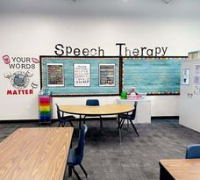


Appearance

Slide 3
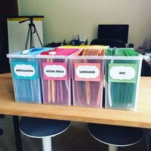
Equipment

Slide 4

Lighting and acoustics

Slide 5

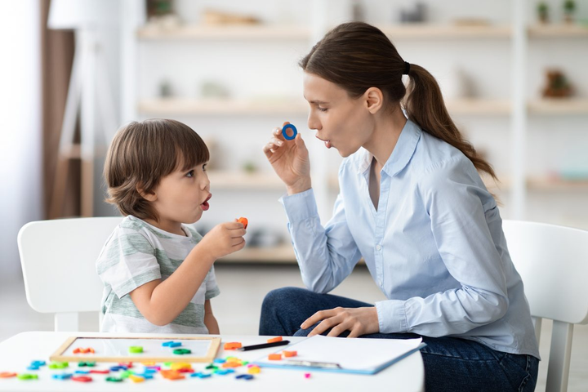



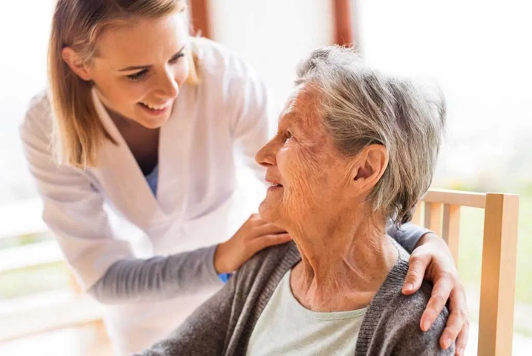


differences and similarities in the therapy of children and adults

Slide 6
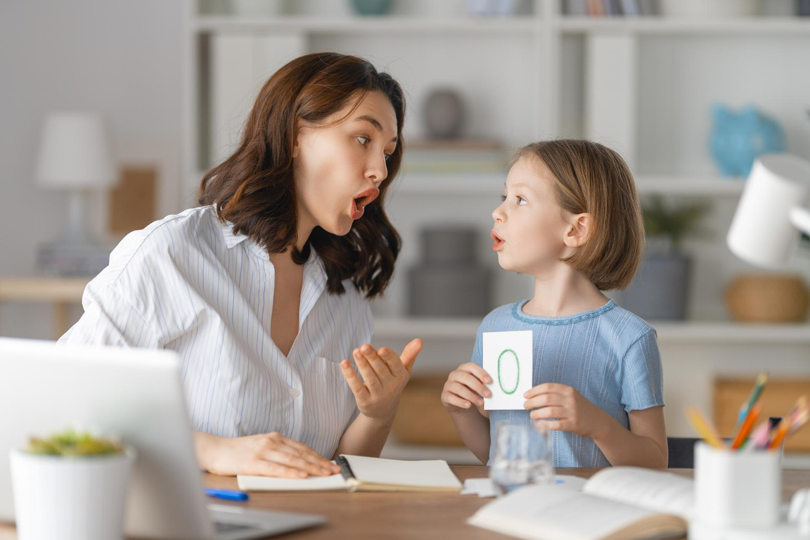
adressing the patient

Slide 7



2. exercises

Slide 8
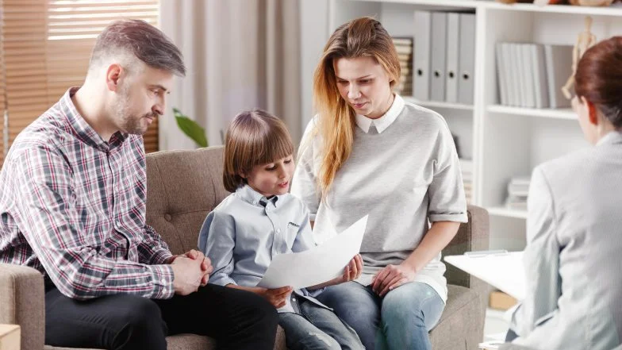
3. cooperation with family or caregivers

Slide 9


4. individual approach

Slide 10





WHAT IS IMPORTANT IN SLP’S OFFICE?

Slide 11

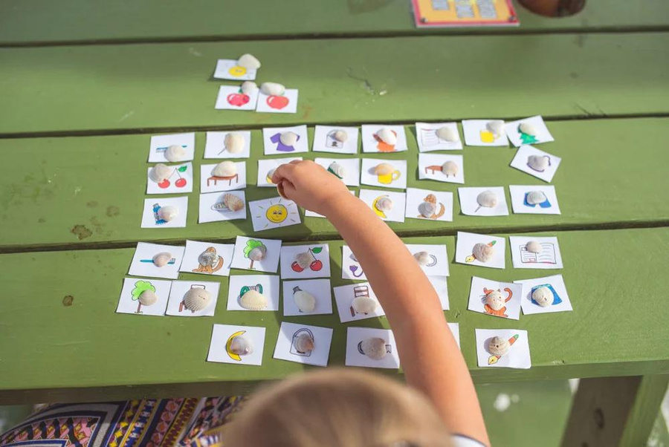
Why they should be used?
diagnosing
01.
Therapy
02.
Developing
communication skills
03.

Slide 12
Basic equipment
1. speech therapy aids
2. computer with speech therapy software
3. mirror

Slide 13
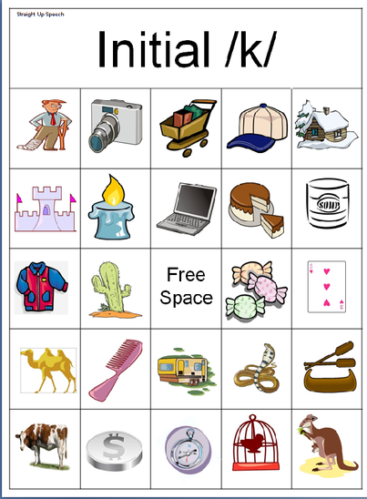
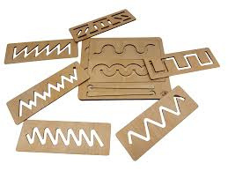
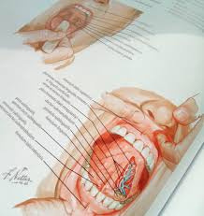

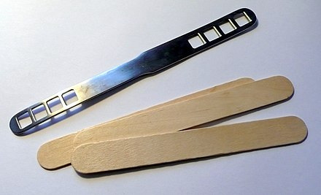
Speech therapy aids that may be useful in a speech therapist's work

Slide 14

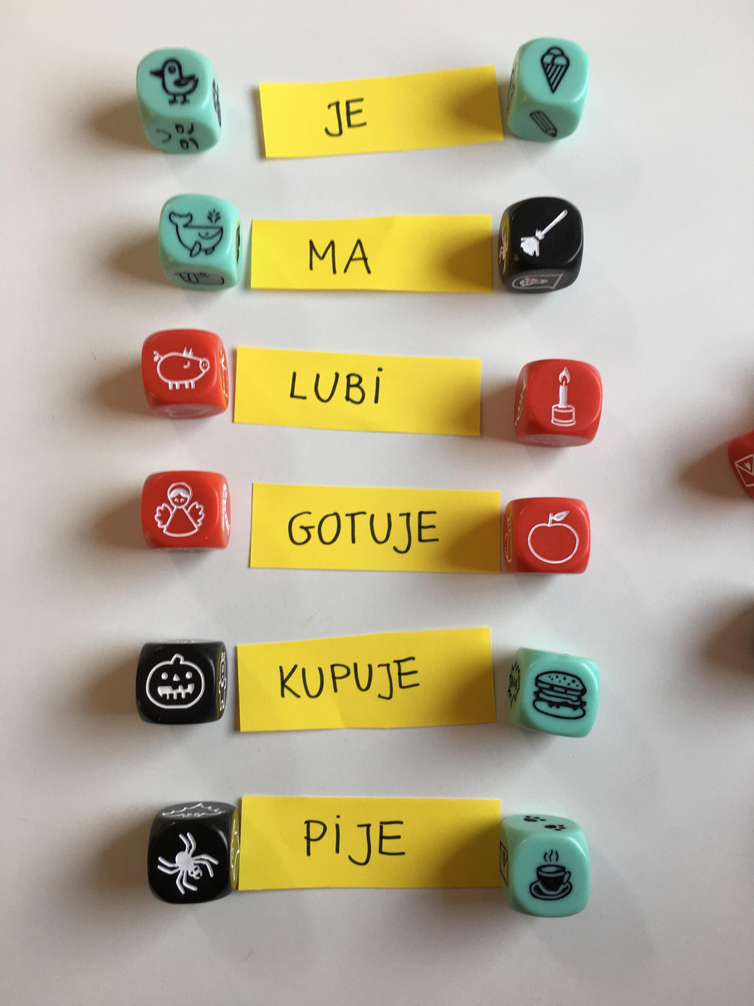


Add a heading

Slide 15








Public heathcare system:
Private:
Speech and language therapy services
Private practice
Hospitals
Part of a therapy center
Clinics

Slide 16

First appointment with the speech and language pathologist
what to expect during your first visit?

Slide 17
how can you Prepare for your first appointment with the SLP?

Slide 18
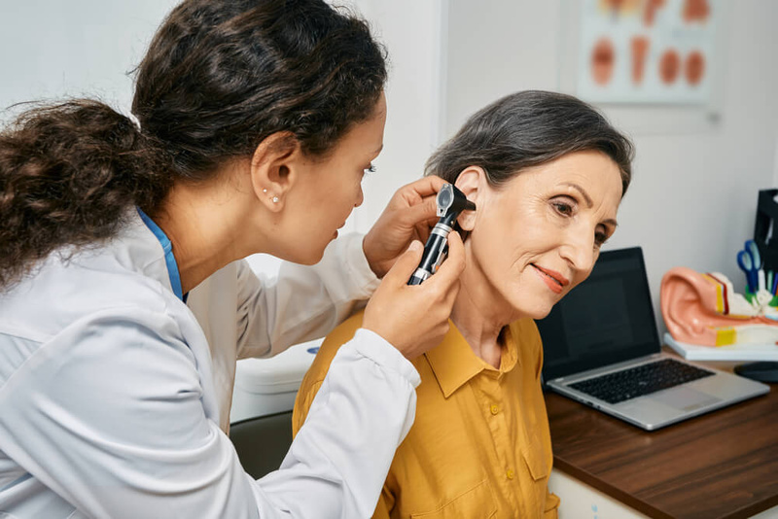
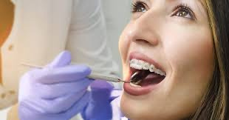
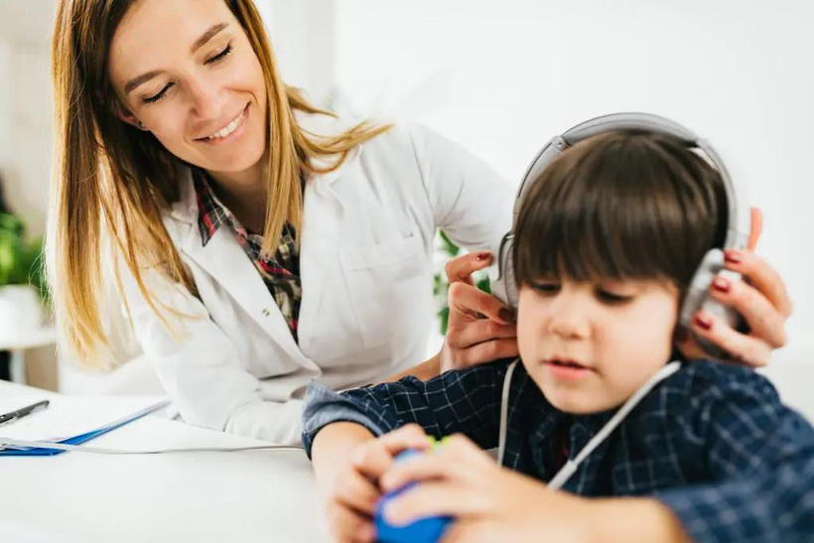
Medical records or reports related to your communication challenges
Cooperation with other specialists

Slide 19
Thank you very much

